Slide 1
Microsoft Project 2010 – Introduction, Part 3
Phil Pfeiffer
Fall, 2014

Slide 2
This Presentation's Structure
Part 1
Common features & their uses
Gantt Chart View
Tasks
Scheduling Modes: Manual Mode
Inter-Task Dependencies
Resources
Other operations on tasks
Part 2
Common features, uses (cont.)
Overallocation
Duration, Units, Work
Scheduling Modes: Auto Scheduling
Scheduling Modes: Recommendations
Part 3
Common features, uses (cont.)
Summary tasks and subtasks
Summary Tasks: Auto Scheduling
Summary Tasks: Inter-Task Dependencies
Calendars
Calendar Management
Part 4
Common features, uses (cont.)
Calendar Management (cont.)
Modifying Calendars
Skewed Calendars
Calendar Architectures
Project Tracking
Key limitations and gotchas

Slide 3
Summary Tasks and Subtasks
Essential for crafting readable work breakdown structures
Miller limit – people can focus on 7 ± 2 items at any given time
Best practice – break projects down into groups of 7 ± 2 tasks
How – layer the project's constituent tasks
Terminology
Summary task – a task that has subordinate tasks
Subtask – a task that has parent tasks
Leaf task – a task that has no subordinate tasks

Slide 4
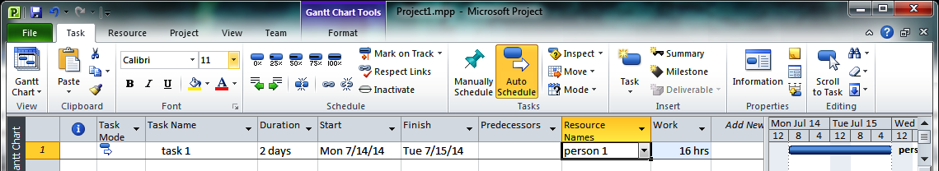
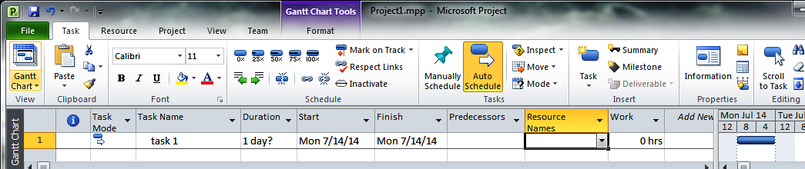
Creating a Subtask, Take 1: Last Task in Project
Starting point – one leaf task, situated at the task list's end.
Strongly recommended: start by deleting this task's duration, resources, and work items. This will allow autoscheduling to compute these values from the subtasks alone, without any confusion created by the summary task's starting parameters (more later).

Slide 5
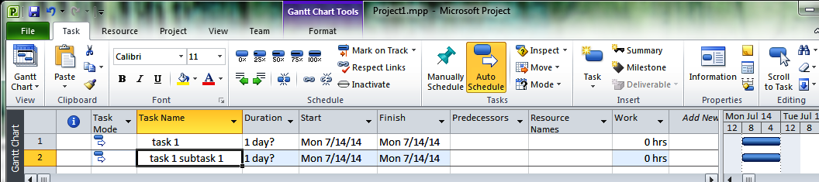
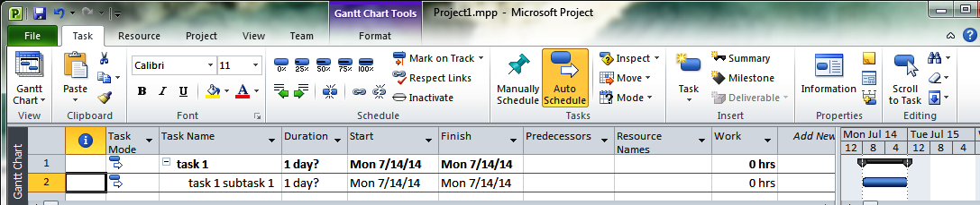
Creating a Subtask, Take 1: Last Task in Project
Enter the new task's name, then deselect the field. Project will initialize the new task to 1 day?, its work to 0, and its start date to the project's start date.
With the new task selected, do either of two actions:
click on the "make subtask" icon on the Task tab
enter alt-shift-right arrow on the keyboard
Finish by completing just the new subtask's parameters (not shown here)

Slide 6
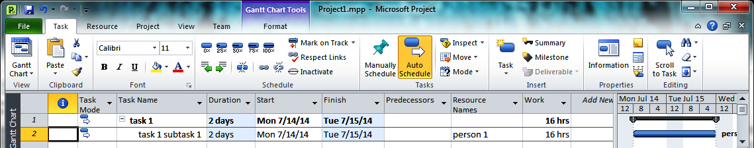
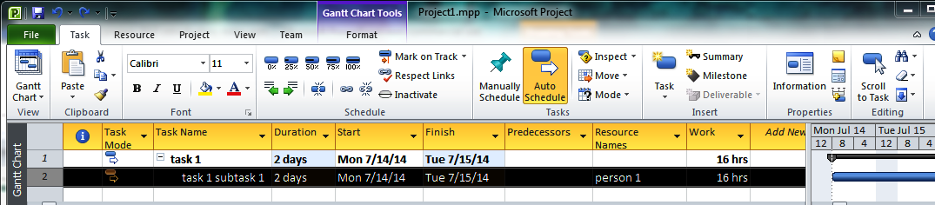
Creating a Subtask, Take 2: for Task w. Subtasks
Starting point – one summary task with one leaf task.
Strongly recommended: start by confirming that summary task has no associated resources.
Select the task that should follow the subtask to add.

Slide 7
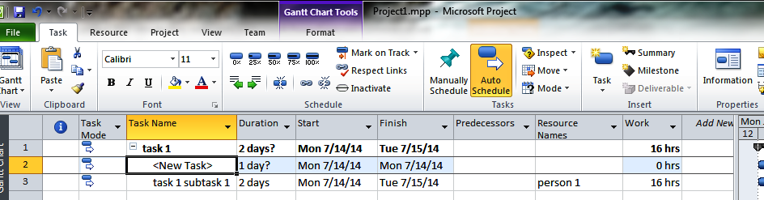
Creating a Subtask, Take 2: for Task w. Subtasks
Right-click on the selected task.
From the dropdown menu that appears, select "Insert Task"
Finish by completing the task parameters (not shown here)

Slide 8
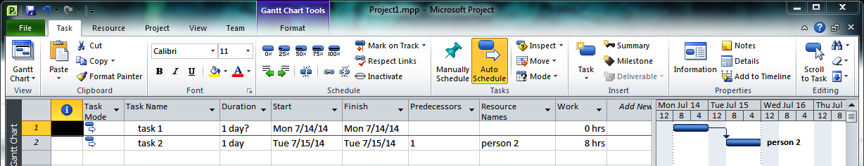
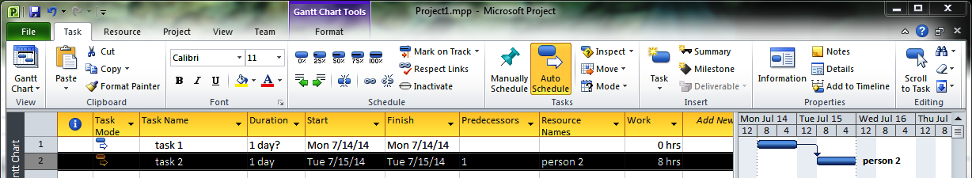
Creating a Subtask, Take 3: for Tasks w/out Subtasks
Strongly recommended: start by confirming that proposed subtask's summary task has no associated resources.
Select the task before which to add the subtask.

Slide 9
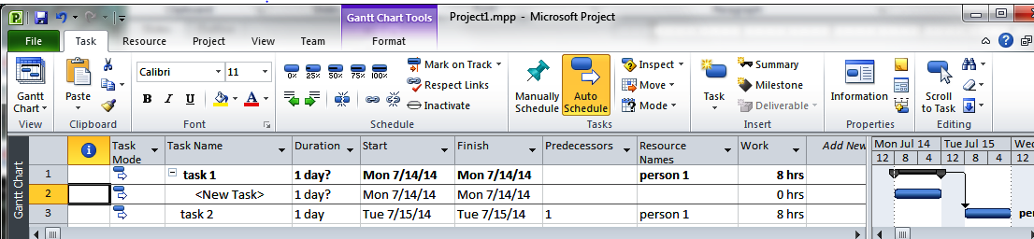
Creating a Subtask, Take 3: for Tasks w/out Subtasks
Right-click on the selected task.
From the dropdown menu that appears, select "Insert Task"
Then, use the Task tab's "make subtask" icon or alt-shift-right arrow to make the new task a subtask of the task above it.
Finish by completing the task parameters (not shown here)

Slide 10
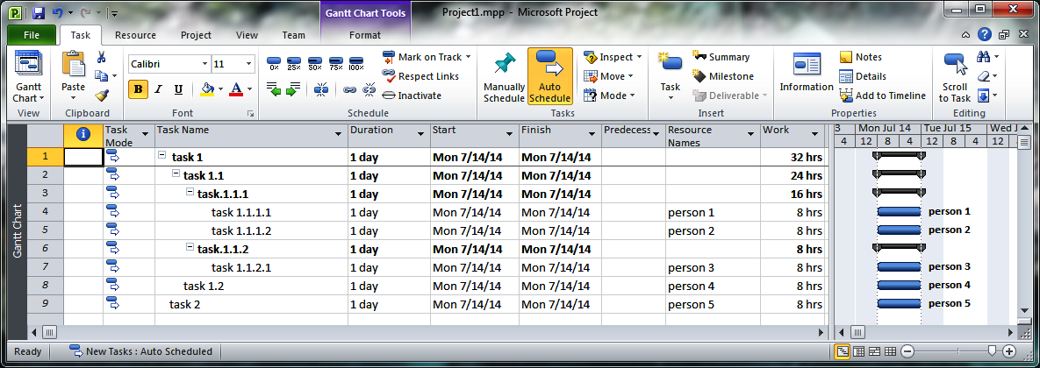
Subtask Visibility
Project uses indentation and +/- icons to show parent-child relationships
a summary task's immediate subtasks are indented by one level
+/- controls indicate whether a task's subtasks are exposed (-) or hidden (+)
In the following project
task 1 is the parent of task 1.1 and task 1.2
task 1.1 is the parent of task 1.1.1 and task 1.2
task 1.1.1 is the parent of task 1.1.1.1 and task 1.1.1.2
task 1.1.2 is the parent of task 1.1.2.1

Slide 11
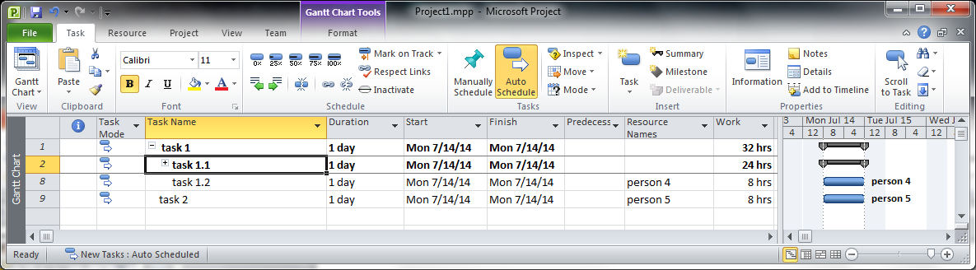
Subtask Visibility
Clicking on the – icon for a summary task with visible child tasks
Changes that task's icon to a + icon
Hides ("Rolls up") that task's child tasks
Roll up, however, is not recursive
If this view has been generated by clicking on task 1.1's icon (as per previous view)
then clicking on the + icon shown here will expose tasks 1.1.1, 1.1.1.1, 1.1.1.2, 1.1.2, and 1.1.2.1

Slide 12
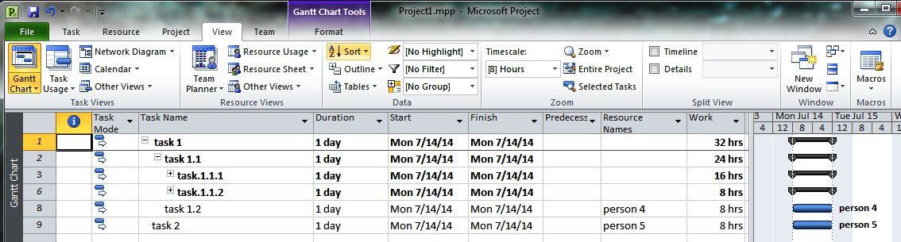
Subtask Visibility
The hiding and unhiding of summary tasks can also be controlled, on a level-by-level basis, using the View tab's Outline control.
The control's pop-up dropdown menu (not shown) has options for
Showing and hiding all of a project's subtasks
Showing all subtasks at or above levels 1, 2, 3, 4, 5, 6, 7, 8, or 9
This view of the project was produced by showing all subtasks at level above or below level 3
These controls, like the per-task +/- controls, are not recursive

Slide 13
Other Operations on Summary Tasks and Subtasks
Cutting, copying, pasting, and deleting summary tasks and subtasks
Similar to cutting, copying, pasting, and deleting tasks, except
Project 2010 prompts before summary task deletion, asking if you really want to remove all subtasks
Project 2010 pastes a block of tasks into a project at the level of task selected as the point of insertion
Reordering a project's summary tasks and subtasks
Similar to reordering tasks, except that Project 2010 pastes a block of tasks into a project at the level of task selected as the point of insertion
Promoting tasks
The level of selected summary tasks and subtasks can be raised by one level in the task hierarchy in one of two ways
Using the task tab's "promote task" (left arrow) icon
Entering alt-shift-left arrow at the keyboard

Slide 14
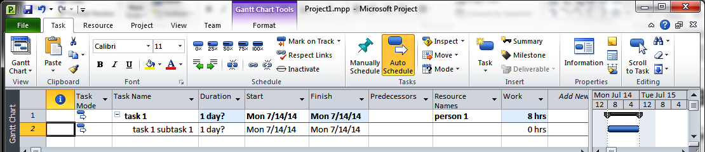
The Summary Task-Subtask Relationship
When an auto-scheduled leaf task is converted to a summary task, Project
highlights the task in bold
sets the task's
start date = start date of the earliest-starting subtask
end date = end date of the latest-ending subtask
duration = elapsed time between its start date and end date
If any of a summary task's subtasks has an uncertain duration– i.e., is shown with ?– the summary task's duration is also uncertain
scheduling mode = fixed duration.
work = total work for all subtasks + assigned work for summary task proper
Project maintains these values automatically in auto scheduling mode.
Neither work nor scheduling mode can be changed in auto-scheduled mode.
Changing start date, end date, or duration flips the mode to manually scheduled.

Slide 15
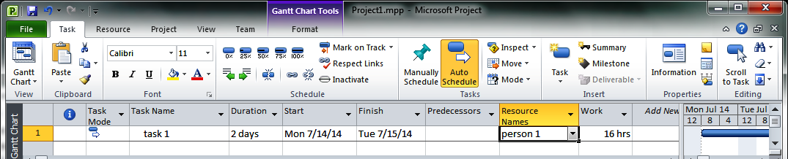
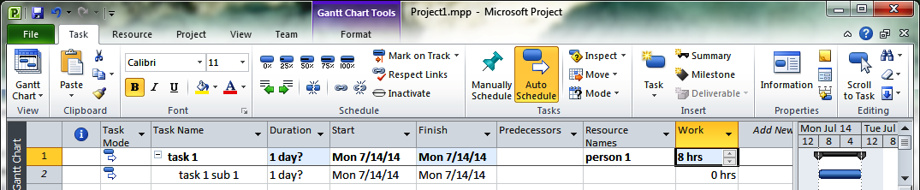
Summary Task Auto Scheduling: Caveats
As a rule, associating a duration, start time, end time, work, or resources with a task before transforming it into a summary task yields counterintuitive results.
Starting point for first task-subtask example
Not following the recommendation– i.e., adding a subtask without clearing task 1's scheduling data—sets task 1's duration to 1 day, assigning that work to person 1

Slide 16
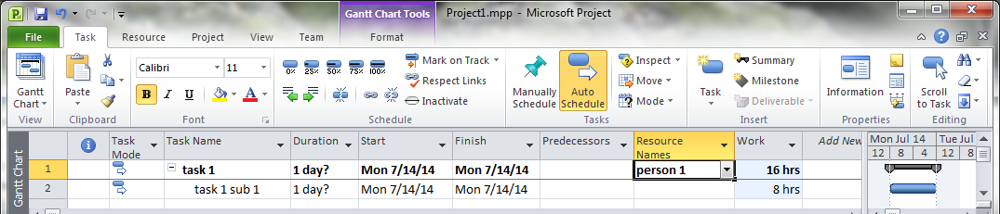
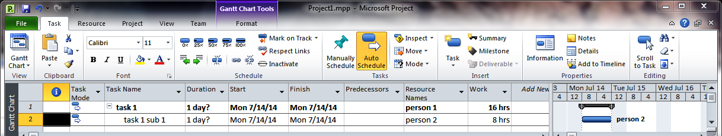
Summary Task Auto Scheduling: Caveats
Changing subtask 1's hours from 0 to 8 adds 8 work hours to person 1's workload for task 1. This is bizarre; subtask 1 hasn't been assigned resources.
Person 2 is now assigned to subtask 1, but person 1 is still held responsible for subtask 1.

Slide 17
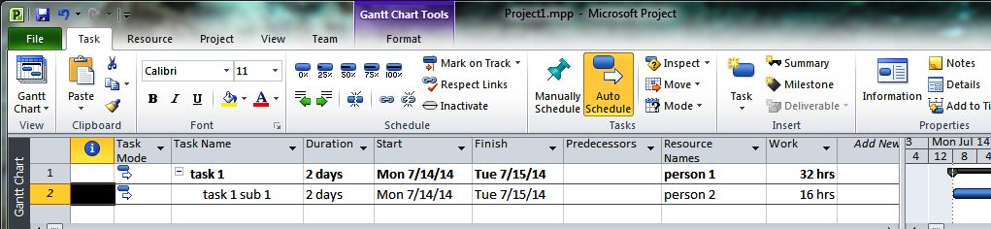

Summary Task Auto Scheduling: Caveats
Changing subtask 1's duration from 1 to 2 days changes its work obligation from 8 to 16 hours (reasonable) while changing task 1's from 16 to 32 hours (???)
I've not found a single reason to assign resources to Project 2010 summary tasks or changing their start, finish, and/or duration fields.
When I've done this accidentally, it's only made a hash of my schedules, resource estimates, or both.
Recommendations:
leave these fields alone
if a summary task really has an associated work load, model this work load as a final subtask.

Slide 18
The Summary Task-Subtask Relationship
As a rule, associating a duration, start time, end time, work, or resources with a task before transforming it into a summary task yields counterintuitive results.
Changing working hours for subtask 1 from 0 to 8 adds 8 hours to person 1's workload for task 1. This is misleading, in that no resources have been assigned to subtask 1.
Person 2 is now assigned to subtask 1, but person 1 is still treated as if that person has full responsibility for subtask 1.

Slide 19
Summary Tasks and Inter-Task Dependencies
The Project Management Institute recommends against including summary tasks in dependencies
because some project management tools apparently only permit dependencies on leaf tasks
because creating such dependencies can produce sub-optimal schedules
I respectfully disagree with this recommendation
Project 2010 supports dependencies involving summary tasks
While summary-task-related dependencies can overconstrain schedules…
… they can also make schedules easier to read

Slide 20
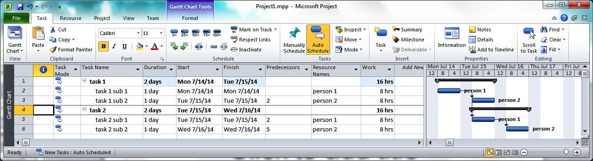
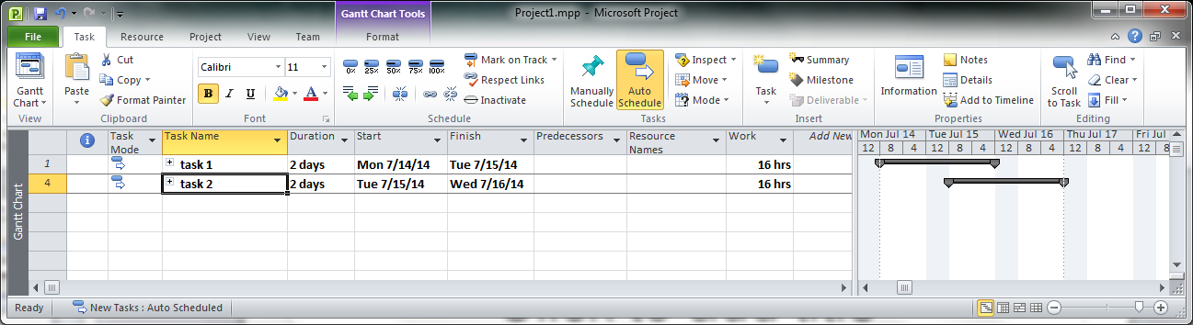
Avoiding Summary Task Dependencies
The schedule above includes a dependency between summary task subtasks.
Thanks to this precise characterization of inter-task dependencies, Project can determine that the summary tasks can be overlapped, yielding a 3-day schedule.
Note that the rolled-up schedule fails to show the inter-summary task dependency.

Slide 21
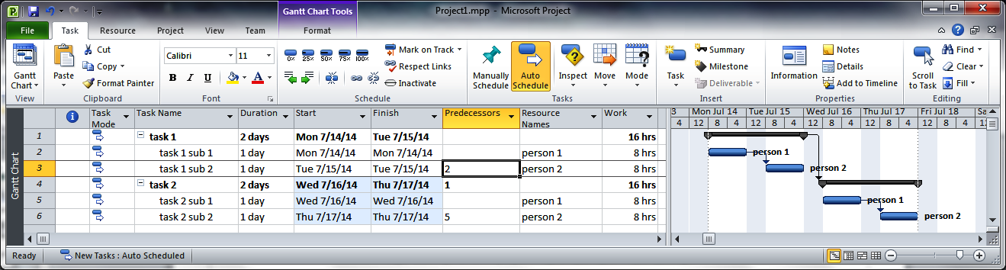
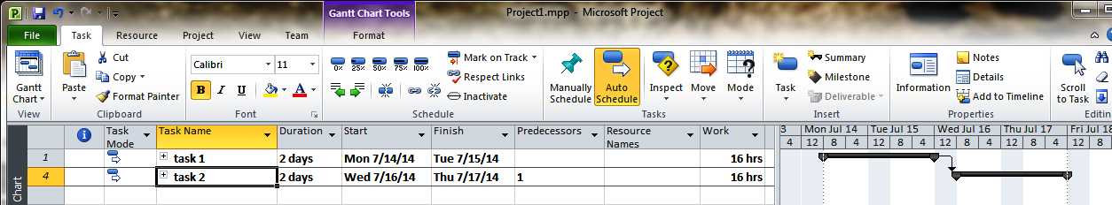
Employing Summary Task Dependencies
The schedule above substitutes the FF dependency 1→4 for the FF dependency 2→4.
This less precise characterization of inter-task dependencies yields a 4-day schedule: a 1-day degradation of the schedule with 2→4.
Note that the rolled-up schedule shows the inter-summary task dependency.

Slide 22
Summary Task Dependencies: Assessment
I see this tradeoff between coarse- and fine-grained dependencies as a tradeoff clarity and optimization
I see the classic precepts about software optimization as relevant to schedule optimization: i.e.,
Don't optimize prematurely
Aphorisms
Alan Perlis: "Optimization hinders evolution".
Tony Hoare: "Premature optimization is the root of all evil."
Recommendations
Make the initial schedule as clear as you can get it
Assess the schedule's performance before optimizing
Optimize (i.e., reschedule) only as many tasks needed
Optimize (i.e., reschedule) the high-payoff tasks first
Don't pessimize needlessly
Example: coarsening a dependency between two level-3 tasks into one between their parent, level-2 dependencies
Example: declaring dependencies between independent tasks

Slide 23
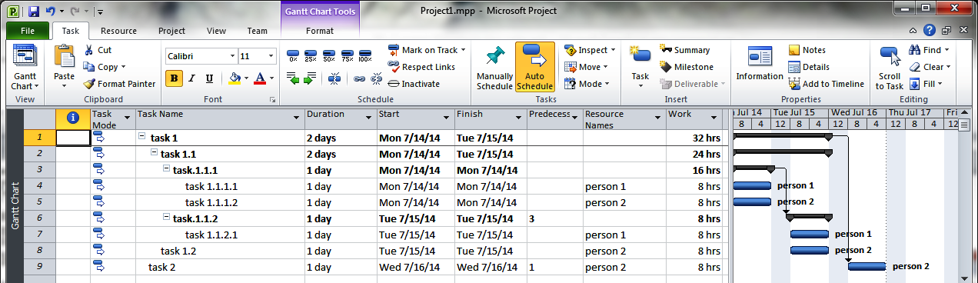
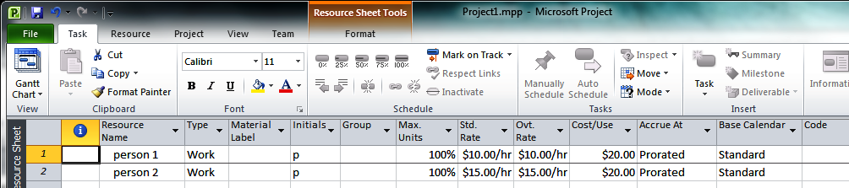
Summary Statistics
For this project, the resource sheet has been used to specify that
person 1 costs $10/hr to hire, plus $20 cost per use – say, traveling expense
person 2 costs $15/hr to hire, plus $20 cost per use

Slide 24
Summary Statistics
For a project like this, summary data on working hours and costs can be obtained from Project 2010's project statistics table

Slide 25
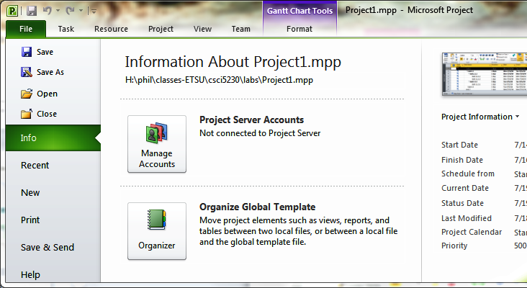
Summary Statistics
The project statistics table can be opened by either
clicking the File tab's Project Information control (right) and selecting project statistics from the resultant two-item dropdown menu (not shown).
clicking the Project tab's Project Information icon (not shown), then clicking on the resultant table's Statistics… control (not shown)

Slide 26
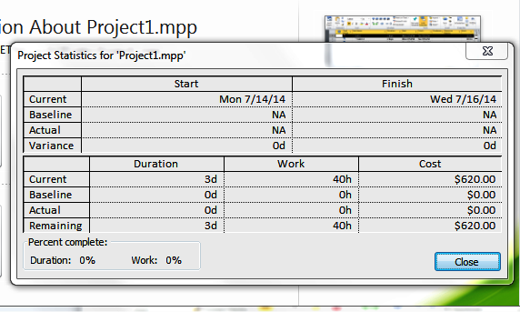
Summary Statistics
The project statistics table shows that
The project will take 3 days and 40 hours' worth of work to finish
The project will cost $620 to finish. This was computed as follows:
person 1: $200, as 16 hrs @ $10/hour + $20 *2 for travel
person 2: $420, as 24 hrs @ $15/hour + $20*3 for travel
No work time has elapsed
No work has been done
No money has been spent

Slide 27
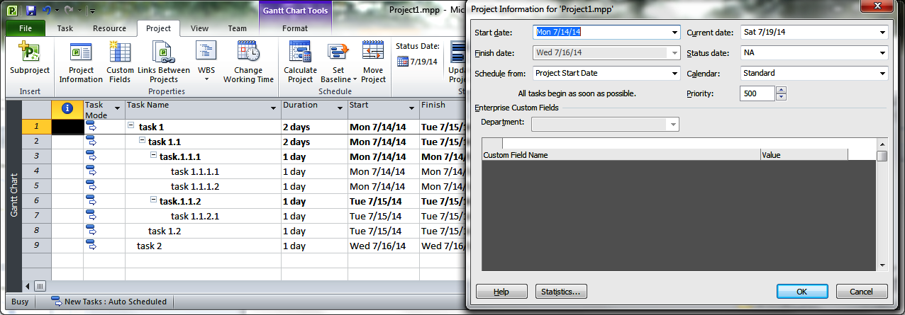
Calendars
Project 2010 uses calendars to calculate schedules
A calendar is a week-by-week – potentially, a day-by-day – declaration of when work can be done
A project's calendars may be viewed by
selecting the Project Tab's Project Information control
clicking on the calendar dropdown control on the table
The resulting dropdown (now shown) should then show the calendars that have been defined for the current project

Slide 28
Calendar Management
Project supplies three built-in master calendars
Standard (8 am-noon, 1-5 pm, 5 days/week, no holidays)
Night shift (11 pm-midnight, 1-3 am, 4-7 am, no holidays)
24 Hour (24 hours/day, 7 days/week, no holidays)
Users can
associate any of these three calendars with a project, task, or resource
create a calendar of their choosing, either
as a customization of one of these three calendars
as a new calendar
customize built-in or custom calendars, by declaring
selected work weeks to have working hours that differ from the norm
selected days to be exceptions (i.e., holidays), where no work is done

Slide 29
Scheduling and Calendars
Project 2010 appears to use the following priorities to select which calendar to use when scheduling tasks: i.e.,
Use the calendar, if any, associated with a given task;
Otherwise, if no calendar is associated with the task,
use the project's master calendar to schedule this task,
subject to any qualifications on scheduling imposed by
the task's resources' calendars: i.e.,
for each task-related resource associated whose base calendar is the project's base calendar
qualify the base calendar with any additional adjustments to work time for that resource
for each task-related resource associated whose base calendar is not the project's base calendar
ignore any additional work time adjustments for that resource
the task's supertasks' calendars: i.e.,
the task's schedule must observe all schedule limitations imposed by all summary tasks that contain that task

Slide 30
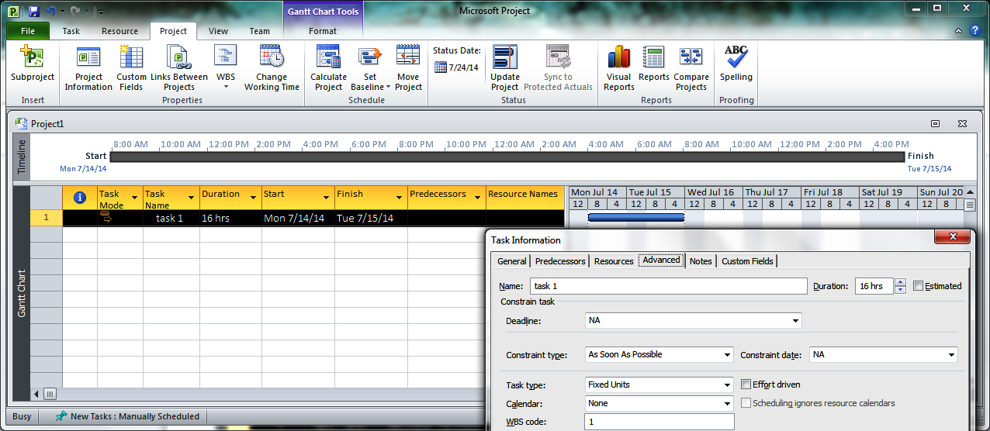
Calendar Management (Default)
A task, when first created, is associated with no resources and no calendars. Its calendar is set to the project's main calendar, which, by default, is Standard.
Here, project spreads the 16-hour task over two 8-hour workdays

Slide 31
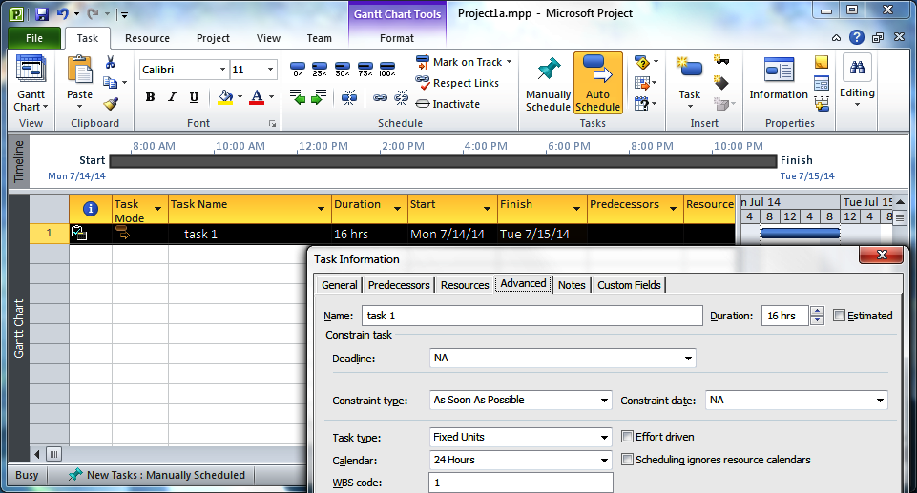
Calendar Management (Tasks)
When task 1 is switched to the 24 hour calendar, Project flags the alternative schedule in the information field and reschedules the 16-hour-long task 1 for 8 am through 12 midnight on 14 July 2014.

Slide 32
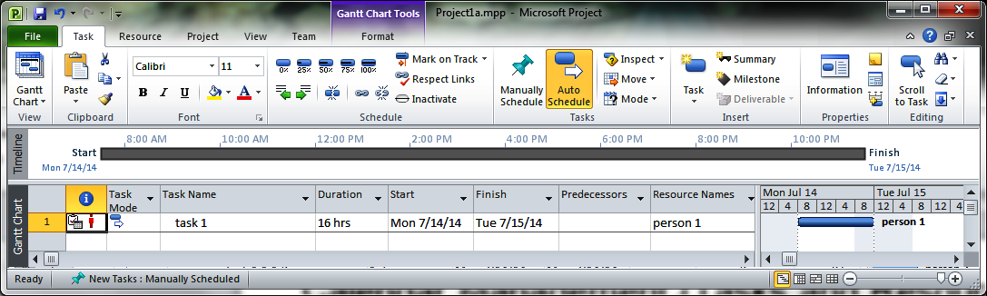
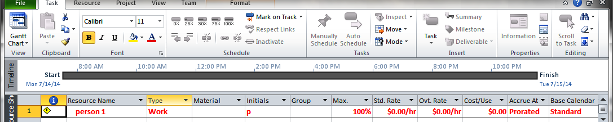
Calendar Management (Tasks and Resources)
When a resource, person 1, is specified for the task, the task continues to be scheduled according to its calendar.
Person 1, however, inherits the project's main calendar as its base calendar – meaning that person 1 is overallocated: i.e., assigned 16 hours in an 8 hour day
Project flags the overallocation in task 1's information box and the resource sheet's line for person 1's

Slide 33
Calendar Management (Tasks and Resources)
Project suggests leveling the resource (person 1) to correct the overallocation; however,
The Project leveling operation continues to schedule project 1 according to task 1's calendar.
Person 1's time remains overallocated
The overallocation can be fixed by resetting task 1's schedule to either
"Standard" – if the task's schedule should continue to take priority over resource schedules
"None" – usually, the better option: it allows resource-driven scheduling

Slide 34
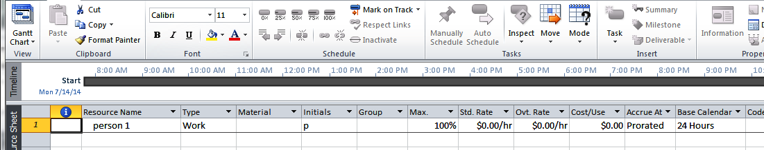
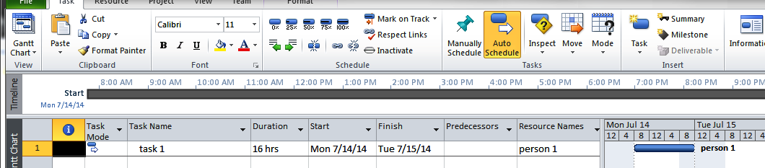
Calendar Management (Resources)
If the calendar for a task with work resources is set to None, the resources' calendars dictate how the tasks are scheduled.
Here, setting person 1's calendar to 24 Hours yields a schedule where person 1 once more finishes task 1 in one 16-hour day.
Note, however, that Project starts person 1's workday at 8 am on 14 July 2014 – even though person 1 is on a 24 hour work clock.

Slide 35
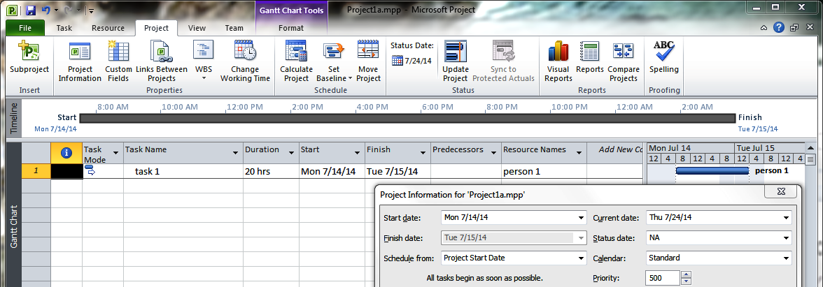
Calendar Management (Resources and Project)
The 8 am start time persists when task 1's duration is increased to 20 hours – a change that produces a schedule ending at 4 am on 15 July
Project, it turns out, is apparently balking at scheduling work before this project's start time. This start time, 8 am on 14 July 2014, is apparently derived from
the project's start date, of 14 July 2014
the project's main calendar, which, being Standard, treats midnight to 8 am as off hours
HOWEVER, Project continues to insist on an 8 am start time after the Project's main calendar is changed to 24 Hours. I'm guessing that this a bug in Project.

